Slide 1

Facial expressions Detector (Comparative study)
Basant Abdelaal – Nada Ayman – Youssef Hussein

Slide 2
Problem
Detecting emotions from images.
Dataset:
The dataset contains 35887 images. It is splitted to training data of size 28821 images, and validation data of size 7066
https://www.kaggle.com/datasets/jonathanoheix/faceexpression-recognition-dataset
Classes:
Happy
Angry
Sad
Surprise
Neutral
Disgust
Fear

Slide 3
Approaches
Cv feature extraction + ML
CNN
YOLO

Slide 4
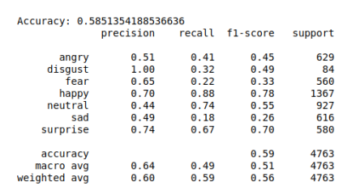
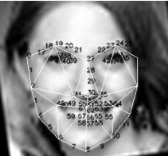
CV feature extraction + ML
Features Extraction:
Facial Detection: Dlib Histogram of Oriented Gradients (HOG) combined with a linear Support Vector Machine (SVM)
68-point Multi-PIE facial landmark mark-up scheme. Feature elimination and selecting best features. (56 poins)
Delaunay triangulation. Again, Feature elimination and selecting best features. (19 points)
Final features:
Detection:
Sci-Kit learm Random Forrest Classifier, with 550 trees.
Results:

Slide 5
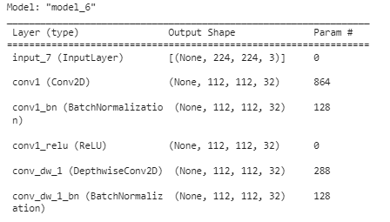
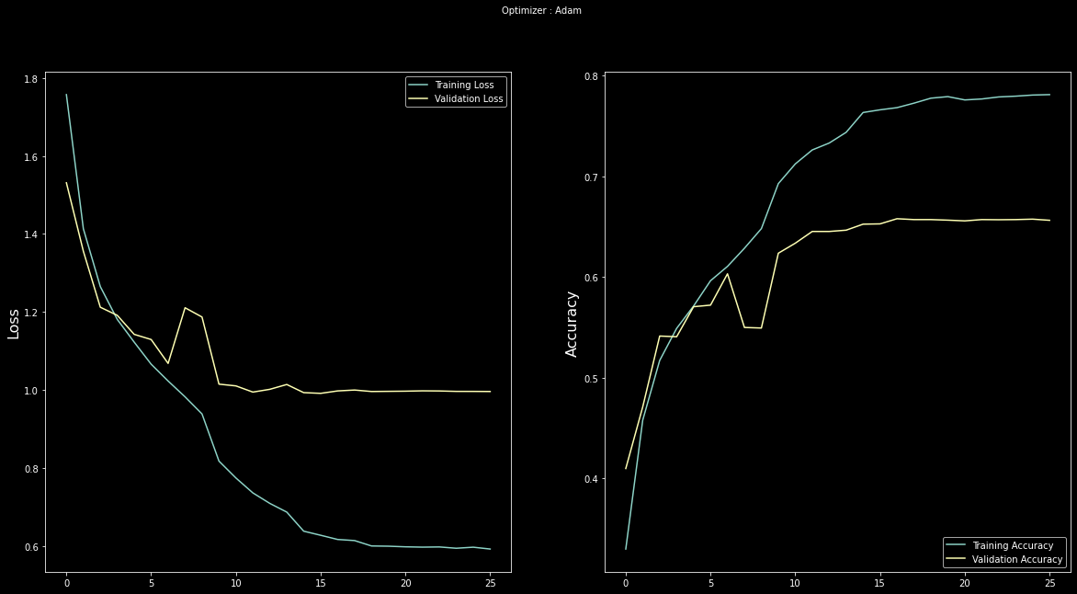
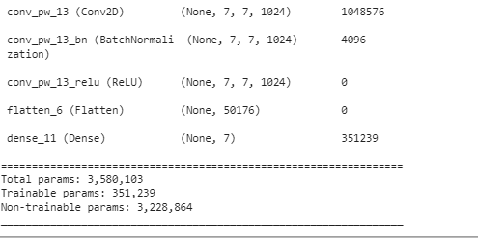
Convolution Neural Network (CNN)
Architecture
Results

Slide 6
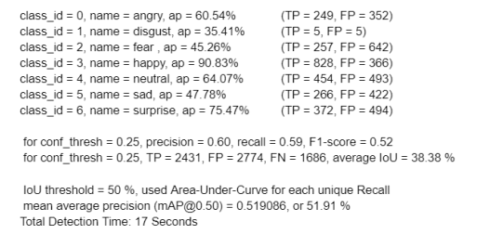
YOLO
Results:
YOLO is an algorithm that detects and recognizes various objects in the image. It is done as a regression problem and gives class probabilities for the detected image.
Automatically labeled the dataset with YOLO format data.
darknet version 4 package was used for implementing the algorithm.

Slide 7

Project Demo

